Slide 1


nnAttention U-net for Brain Tumor Segmentation
Mattia Capparella
ID Number 1746513
Advisor
Maria de Marsico
External Advisors
Ilaria Gianoli Manuel Orlandi

Slide 2
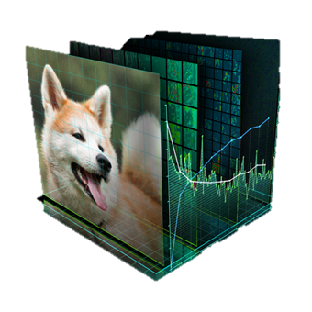



Introduction
Notes:
objective of the thesis
Goodmorning, I’m Mattia Capparella, enrolled in Computer Science Master Course.
Fond of Computer Vision and passionate about the medical sciences, I had the opportunity to combine these two fields preparing my thesis while working for the Company named Reply Data.
I had the chance to propose and get the approval for a solo R&D project in the area Semantic Segmentation, in particular on Brain Tumor Segmentation and for this I would thank in advance my external advisors Ilaria Gianoli and Manuel Orlandi and my internal advisor, the professor Maria de Marsico.

Slide 3
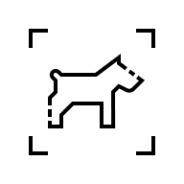
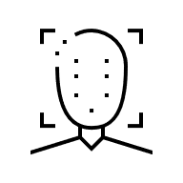

Computer Vision
CLASSIFICATION
DETECTION
SEGMENTATION
Notes:
So: what’s Computer Vision? It is a sub-group of Artificial Intelligence that enables devices to process and understand digital images and videos to extract useful information. The main goal is to develop (super) human vision capabilities in task such as classification, detection and segmentation.
Classification is used to determine what’s the object in an image
Detection allows to localize where that object is
Segmentation is about classifying pixels belonging to a certain category and it is particularly useful in delineating objects and makes easier to understand for us what an intelligent agent does and sees

Slide 4
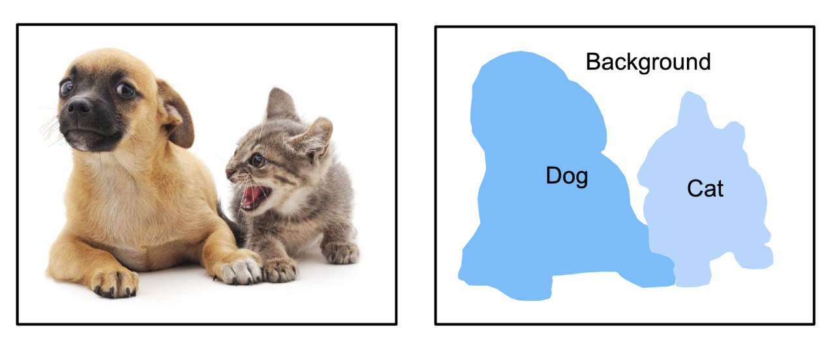
Semantic Segmentation
Notes:
Segmentation involves locating objects or regions of interest precisely in an image by assigning a label to every pixels in an image. With high probability, pixels with the same label share similar characteristics, such as color or texture, or whatever feature that can be used for tell apart different pixels.
It can be easily guessed that such Segmentation capabilities could be effectively used in medical imaging for performing task like automatic and rapid detection of tumors in early diagnosis.
Of course, Computer Vision cannot by itself be trusted to provide definitive diagnoses, but it is certainly an invaluable part of modern medical diagnostic techniques, reinforcing what phsicians already think or providing information that they could have missed.
And let’s consider that if an MRI scan can take 15 to 90 minutes to be acquired, the time taken to generate the complete results depends on several factors: the level of medical emergency for that scan, when in the week the scan was acquired, the radiology availability,… a machine that assesses MRI scans could reduce the burden on these specialists, increasing the overall productivity.

Slide 5
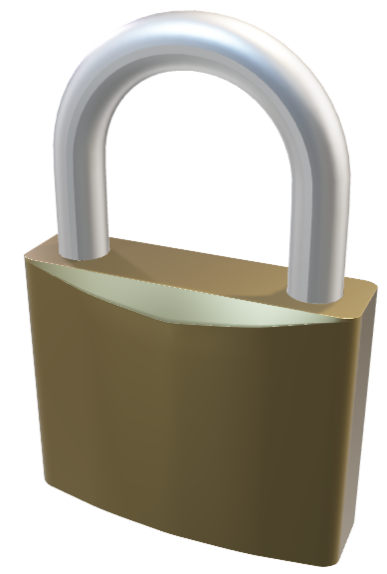
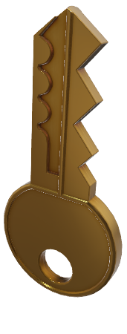
Key Concepts
Notes:
Before dive deep in my work, let’s briefly review the enabling technologies for such super human capabilities in Computer Vision

Slide 6
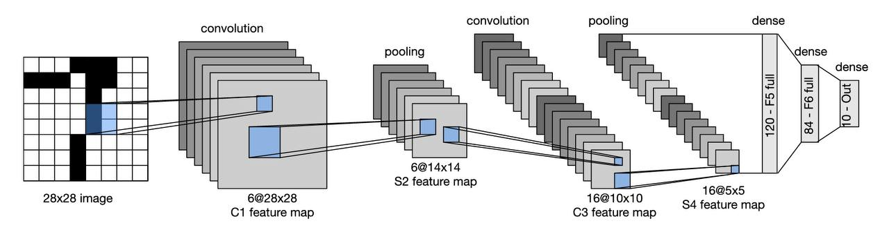
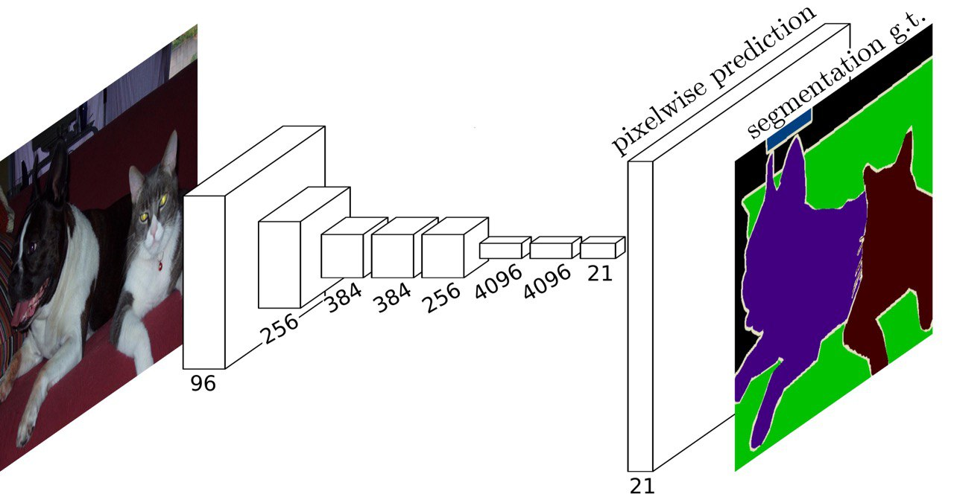
Convolutional Neural Network
Fully Convolutional Neural Network

Slide 7
Fully Convolutional Neural Network
Long,J., Shelhamer, E., Darrel, T., 2015. Fully Convolutional Networks for Semantic Segmentation, arXiv:1411.4038
Notes:
Describe briefly the concept of Neural Network
Describe the transformation from «input» to «desired output», here: the segmentation mask
Anticipate the two points of view of the same task: from a grid of points to a sequence problem
Anticipate the cornerstones of these two models
When talking about Semantic Segmentation we often refer to Fully Convolutional Neural Network: network composed mainly by Convolutional Layer used to extract semantic and geometric information from the original input and combine them in the final predicted output, resulting (hopefully) in the desired segmentation of the objects in the original image.
… but what’s exactly is that convolution operation? And how is it performed?

Slide 8
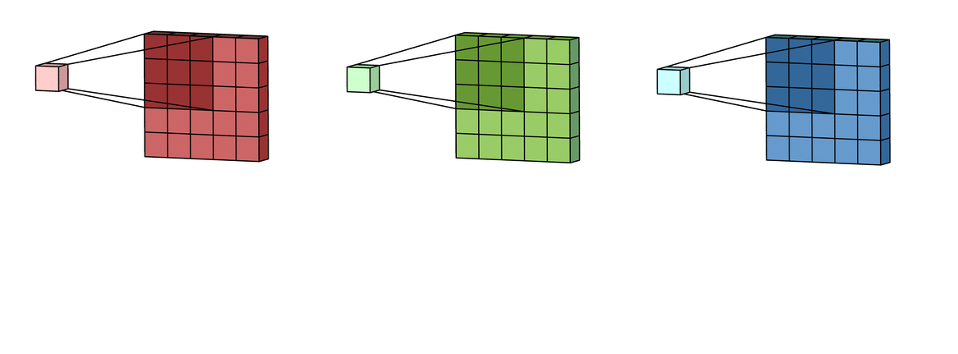
Convolution
INPUTS
FEATURE MAPS
Notes:
https://developer.nvidia.com/discover/convolution
https://timdettmers.com/2015/03/26/convolution-deep-learning/
https://www.tutorialspoint.com/signals-and-systems-relation-between-convolution-and-correlation
Describe briefly what the Convolution is, what it does, why it is useful for image processing
The convolution is a mathematical operation which describes a rule of how to combine two pieces of information to form a third (new) one. The original image is transformed along the FCNN by means of stacked filters (kernels): these are combined (slided from left to right and top to bottom) with image to form a sequence of new images that we call feature maps. These maps soon drift from the original rapresentation, but the passing through the network allow for the filters to learn how to extract useful information and discard useless one. A powerful and intuitive interpretation of the convolution for deep learning is thinking the kernels as feature detectors that outputs large values when the feature described by the kernel itself is detected in the image, so…

Slide 9
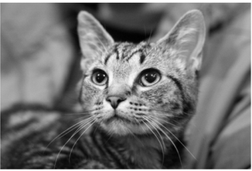
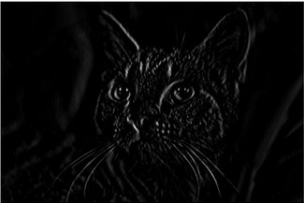
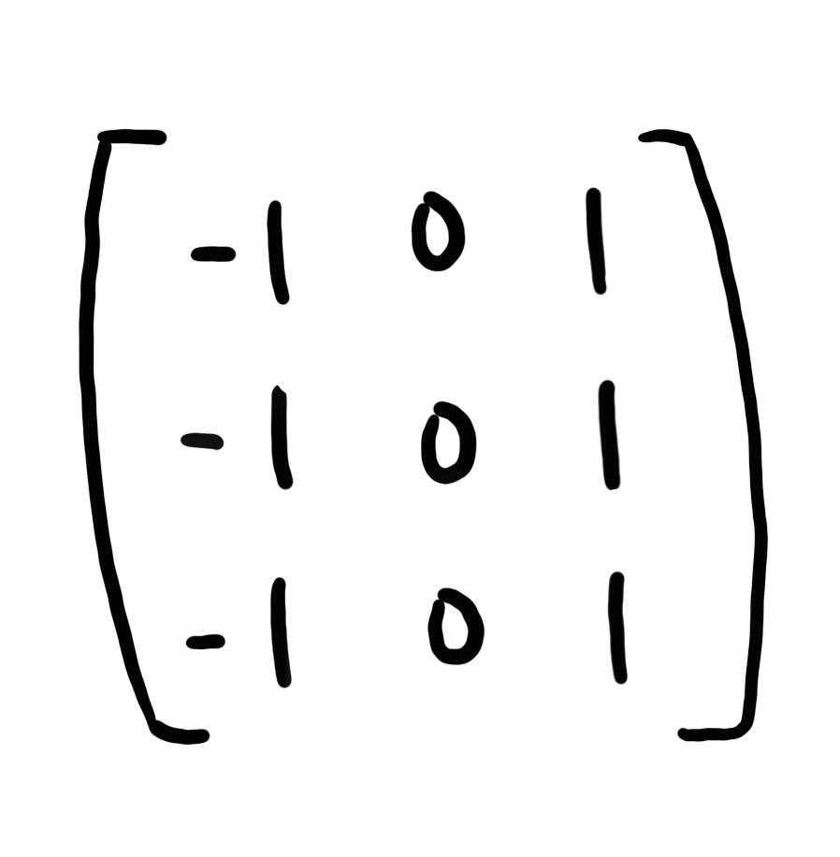
Convolution
Notes:
For examples: convolving the image with filter for vertical edges, we know that it will produce large outputs (visible in white in the right image) when it encounters vertical lines.

Slide 10
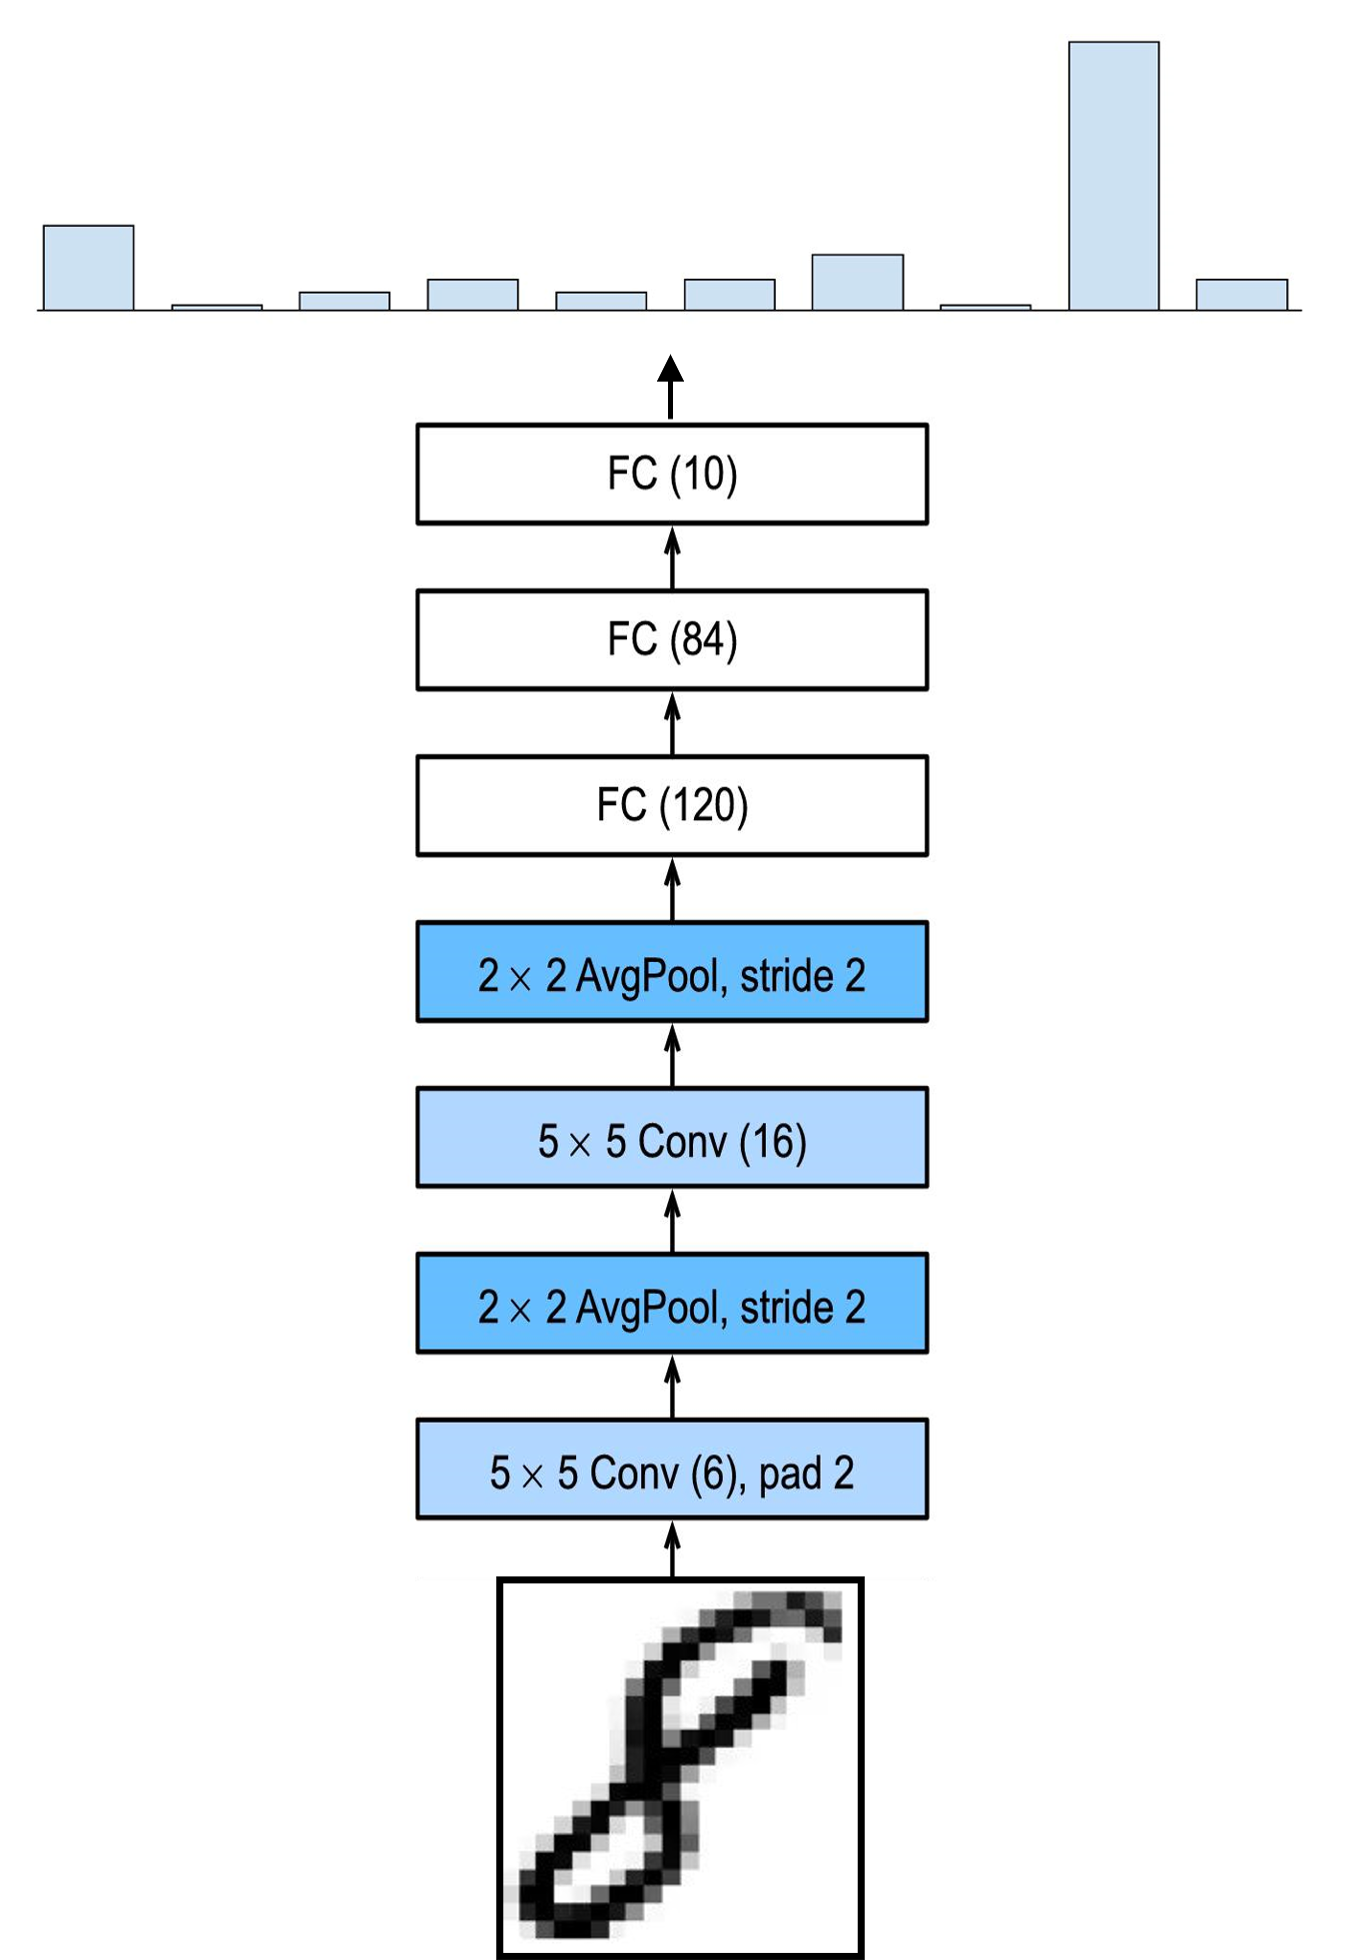
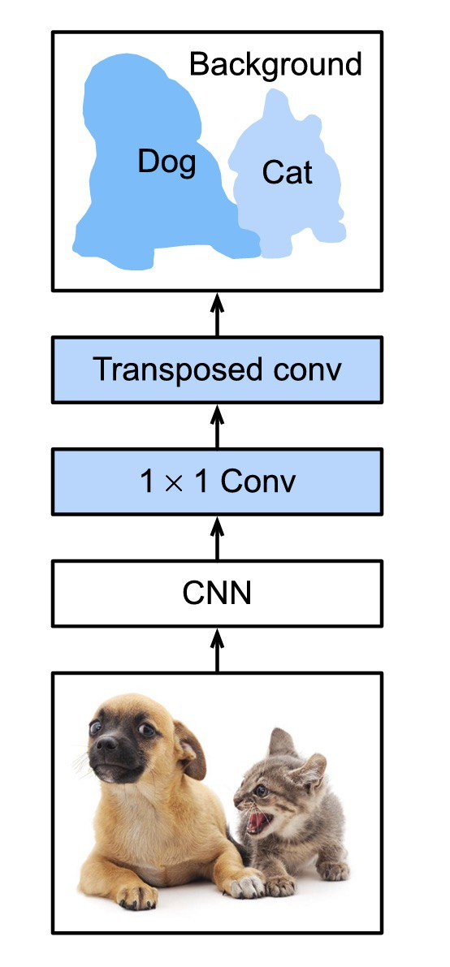
Notes:
Describe briefly the idea of «feature extraction» (common to different models/tasks) and the concept of «head» (classification Vs segmentation)
We have seen how to reduce (extract) the information, but once we are arrived to a bottleneck, we have to expand again this information to the original spatial resolution and at the same time yield a prediction for each pixels: we do so by using transposed convolution: this operation broadcasts input elements via the kernel, therby producing an output that is larger than the input they receive. We do so for multiple stage up until we restore the original spatial dimension, but with as many layers as the labels we would like to predict.

Slide 11
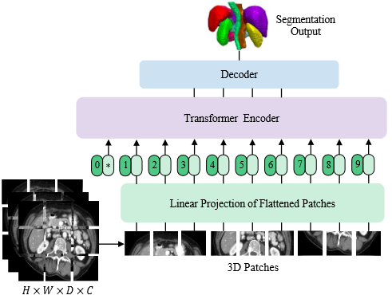
Vision Transformer
Dosovitskiy, A., Beyer, L., Kolesnikov, A. et al., 2020. An Image is Worth 16x16 Words: Transformers for Image Recognition at Scale, arXiv:2010.11929v2
Notes:
Describe briefly the functioning of the model (in particular the patch partiioning scheme)
Anticipate the Attention mechanism of the Transformer architecture
Convolution has been one of the most useful tool for information extraction in CV, but in recent years it has gained a new rival. First popularized in the Natural Language Processing (NLP) domain, the self-attention mechanism has gained popularity even in Computer Vision, when the first Image Transformer was proposed in 2020. The adoption of the Transformer architecture instead of the classical CNN for CV tasks required a fundamental change in how the image is processed: from a monalitich artifact we disrupt it into a sequence of patches that are first flattened and then projected into an embedding space before getting fed to the Transformer Encoder: let’s see the rationale behind this approach and what «attention» is!

Slide 12
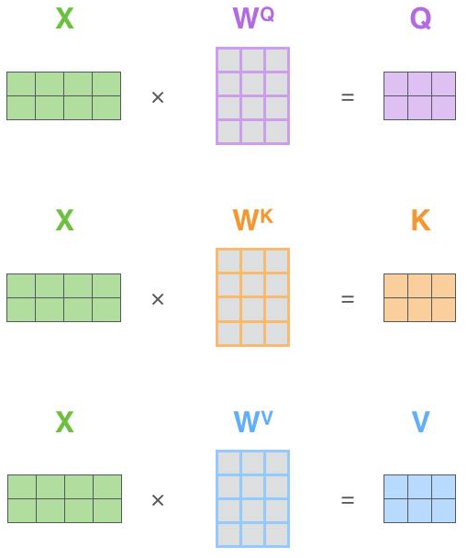

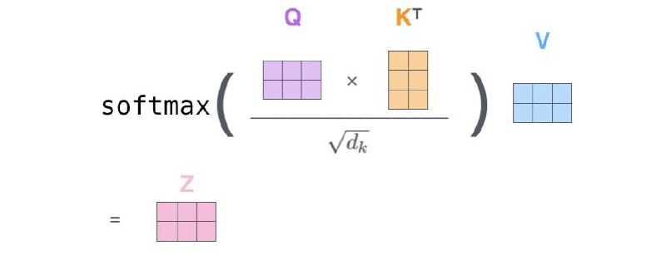
Attention
Notes:
https://lightning.ai/docs/pytorch/stable/notebooks/course_UvA-DL/05-transformers-and-MH-attention.html
https://uvadlc-notebooks.readthedocs.io/en/latest/tutorial_notebooks/tutorial6/Transformers_and_MHAttention.html
http://jalammar.github.io/illustrated-transformer/
https://lilianweng.github.io/posts/2020-04-07-the-transformer-family/
https://blogs.nvidia.com/blog/2022/03/25/what-is-a-transformer-model/
https://en.wikipedia.org/wiki/Vision_transformer
https://lightning.ai/docs/pytorch/stable/notebooks/course_UvA-DL/11-vision-transformer.html
Describe the Attention mechanism in general terms
Comment the domain crossing, from NLP -> Vision
Briefly comment the differences between Convolution and Attention:
Complexity
Advantages, Disadvantages
Inductive, Invariance and Equivariant biases
Locality vs Globality
Proposed in 2014 and refined in 15, the attention was a mechanism which highly improved the quality of machine translation systems (as Google Translate): this technique allows the model to focus on the relevant parts of the input sequence as needed, and bypass the others.
An attention function can be described as mapping three vectors to a final output that is a sum of the values from one of these vectors, weighted by a combination of the other two according to a compatibility function.
Computing self-attention for each encoder’s requires 6 steps:
From the original embedding of each word we create the 3 vectors named Query, Key and Value (to do so, we use 3 trainable matrices W^{Q}, W^{K} W^{V} )
For a specific embedding, we compute its score w.r.t. each other word in the input sequence. The score determines how much focus to place on other parts of the input sequence w.r.t. self.
Then we first normalize all the scores and make them to sum up 1 via softmax so to consider these scores as probabilities
Multiply the values of each embedding by the normalized scores so to keep intact the values of the words we want to focus on, and zero the irrelevant parts
Finally the value vectors computed for a specific embedding are summed up and that’s the final score for the self-attention at that position.

Slide 13
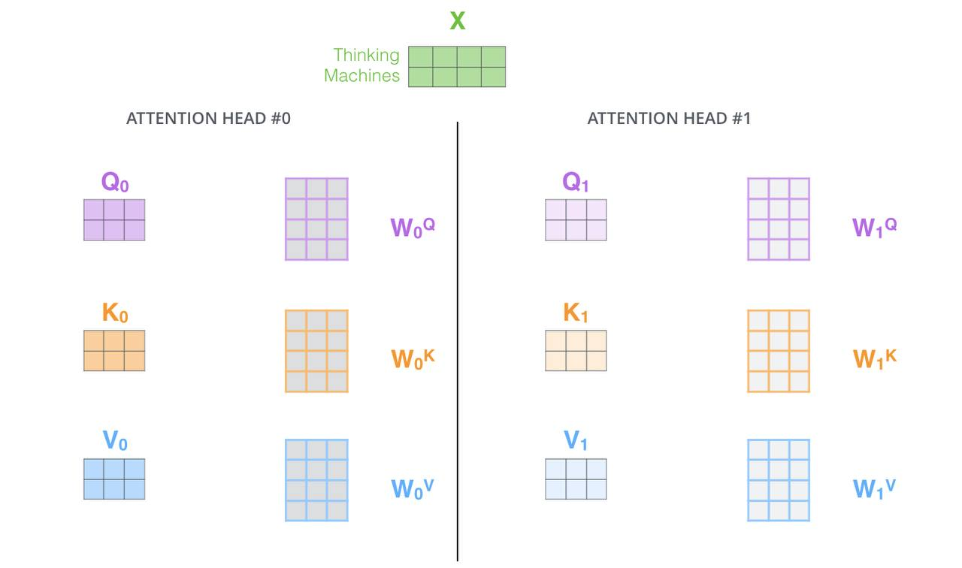
Attention
Notes:
https://lightning.ai/docs/pytorch/stable/notebooks/course_UvA-DL/05-transformers-and-MH-attention.html
https://uvadlc-notebooks.readthedocs.io/en/latest/tutorial_notebooks/tutorial6/Transformers_and_MHAttention.html
http://jalammar.github.io/illustrated-transformer/
https://lilianweng.github.io/posts/2020-04-07-the-transformer-family/
https://blogs.nvidia.com/blog/2022/03/25/what-is-a-transformer-model/
https://en.wikipedia.org/wiki/Vision_transformer
https://lightning.ai/docs/pytorch/stable/notebooks/course_UvA-DL/11-vision-transformer.html
The paper further refine the self-attention layer by adding a mechanism called «Multi-headed» Attention: different matrices are used for the subspace projection of the three vectors: this enable the model to focus on different positions, parts of the speech or, in the case of images: visual cues (geometries, textures, colors and so on)

Slide 14
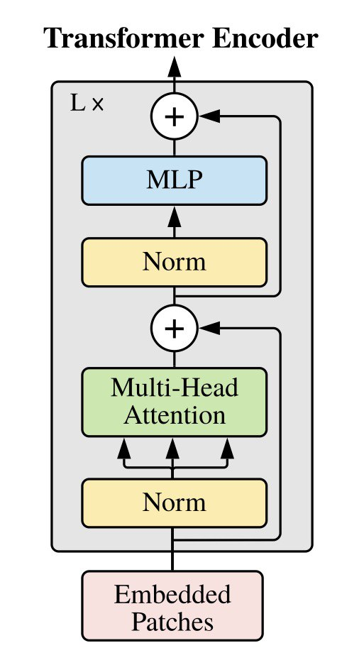

Attention
Notes:
https://lightning.ai/docs/pytorch/stable/notebooks/course_UvA-DL/05-transformers-and-MH-attention.html
https://uvadlc-notebooks.readthedocs.io/en/latest/tutorial_notebooks/tutorial6/Transformers_and_MHAttention.html
http://jalammar.github.io/illustrated-transformer/
https://lilianweng.github.io/posts/2020-04-07-the-transformer-family/
https://blogs.nvidia.com/blog/2022/03/25/what-is-a-transformer-model/
https://en.wikipedia.org/wiki/Vision_transformer
https://lightning.ai/docs/pytorch/stable/notebooks/course_UvA-DL/11-vision-transformer.html
Self-attention allows to integrate for information across the entire image even in the lowest layers, while other heads have highly localized attention as to mimic the ealry convolutional layers in CNN detecting «low level features» (edges, corners, and so on…).
Nevertheless, transformers have fewer inductive biases than CNNs (e.g., translation equivariance and locality) and thus suffer when the given amounts of training data are insufficient. So, it was a good opportunity to test both these variants on a dataset with a limited number of examples.

Slide 15

Attention
Notes:
https://lightning.ai/docs/pytorch/stable/notebooks/course_UvA-DL/05-transformers-and-MH-attention.html
https://uvadlc-notebooks.readthedocs.io/en/latest/tutorial_notebooks/tutorial6/Transformers_and_MHAttention.html
http://jalammar.github.io/illustrated-transformer/
https://lilianweng.github.io/posts/2020-04-07-the-transformer-family/
https://blogs.nvidia.com/blog/2022/03/25/what-is-a-transformer-model/
https://en.wikipedia.org/wiki/Vision_transformer
https://lightning.ai/docs/pytorch/stable/notebooks/course_UvA-DL/11-vision-transformer.html

Slide 16



Main Work
the problem
SOTA
proposed solution
Notes:
Sum up the whole process involved for the period of my thesis:
How I documented on the problem
Where I found the existing solutions (papers, blogs, tutorials…)
What I did to propose my solutions
In the following sections I will introduce:
the problem/task I worked on,
the relevant literature reviewed before starting the development of my solution
the methodology I followed to obtain reproducible and accessible results, while maintaining a flexible structure of the project, so to allow for quick prototyping, hypothesis testing and so on
At the end, I will show the results, discuss about the future work and recent improvements in Semantic Segmentation

Slide 17
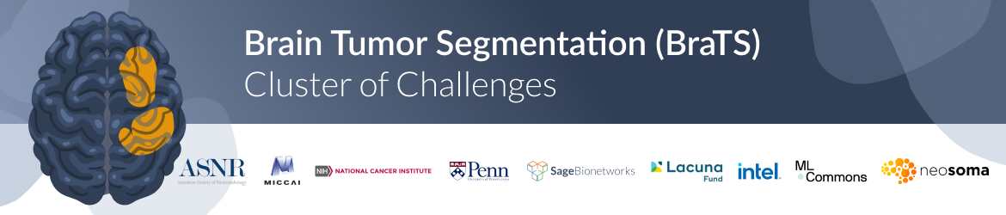
The problem
Notes:
Briefly describe the problem as stated in the BraTS challenge
Say why this is difficult compared to other segmentation problem (variability of target, scarcity of data, high resolution of data -> hw problem)
Since 2012, the International Brain Tumor Segmentation (BraTS) challenge has focused on the generation of a benchmarking environment and dataset for the delineation of adult brain tumors (namely gliomas).
The dataset version I used for both reproducing SOTA results and to train my solution is the 2018 BraTS version: the data are routine clinically-acquired, multi-site multiparametric magnetic resonance imaging (mpMRI) scans of brain tumor patients and focuses on the segmentation of intrinsically heterogeneous tumors (in appearance, shape and histology).

Slide 18
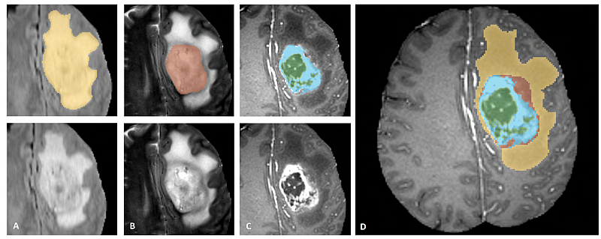
The problem
WHOLE TUMOR
TUMOR CORE
ENHANCING TUMOR
EDEMA
NON-ENHANCING
ENHANCING
NECROSIS
Notes:
Briefly describe the problem as stated in the BraTS challenge
Say why this is difficult compared to other segmentation problem (variability of target, scarcity of data, high resolution of data -> hw problem)
** OLD **
Edema (green)
Necrotic Tumor (red)
Non-enhancing tumor (blue)
Enhancing tumor (yellow)
** OLD **
For each sample in the dataset, professional segmentation is provided as ground truth labels for the training part. The labels in the right figures evidence all the tumor sub-regions that the experts annotated, but a smaller set of final labels is requested by the challenge.
While in the figure we see:
Edema (yellow)
Necrotic Tumor (green)
Non-enhancing tumor (red)
Enhancing tumor (light blue)
The challenge asks instead to segment 3 overlapping subregions:
Enhancing Tumor
Tumor Core (enhancing tumor + necrotic and non-enhancing tumor core)
Whole Tumor (edema + tumor core)

Slide 19
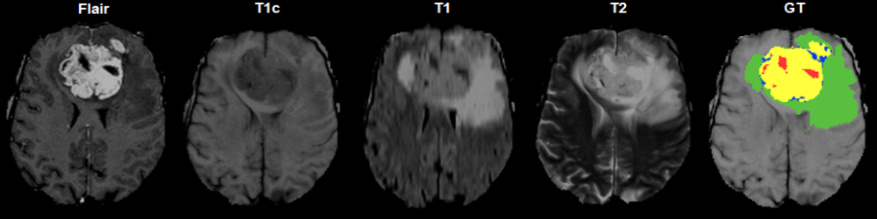
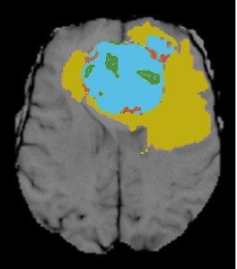
The problem
Notes:
Briefly describe the problem as stated in the BraTS challenge
Say why this is difficult compared to other segmentation problem (variability of target, scarcity of data, high resolution of data -> hw problem)
Consider for a moment just the image on the left: it is a slice of an MRI scan showing a portion of the brain.
Even without being a trained radiologist or a medical practicioner, a round shaped mass can be spotted at top center part of the scan… but we could have easily missed many other information, such as the edema, the non enhancing part, and the small portion of enhacing tumor in the top-right corner.
That’s because what we are seeing is a particular modality of MRI scan that has been tuned by an expert radiologist to show/enhance some peculiarity of the tumor areas.

Slide 20
A multimodal problem
Notes:
Address some resources used to get more knowledge of the problem
Talk briefly about the multi-modality setting of the task
For a complete and deeper analysis, it is often necessary to acquire multiple snapshots of the same sections with different contrasts so to highlight as many different tissues as possible and have a complete understanding of the progression of the disease.
Having more data to analyze is for sure beneficial for a successfull examination, but on a radiologist perspective more data means more time to spend on a single patient and higher probability to miss something important.
On the other hand, a machine can easily parallelize the work, but it is harder to learn how to combine these different sources of information and how to supress the non-relevant information that in this scenario is more abundant

Slide 21
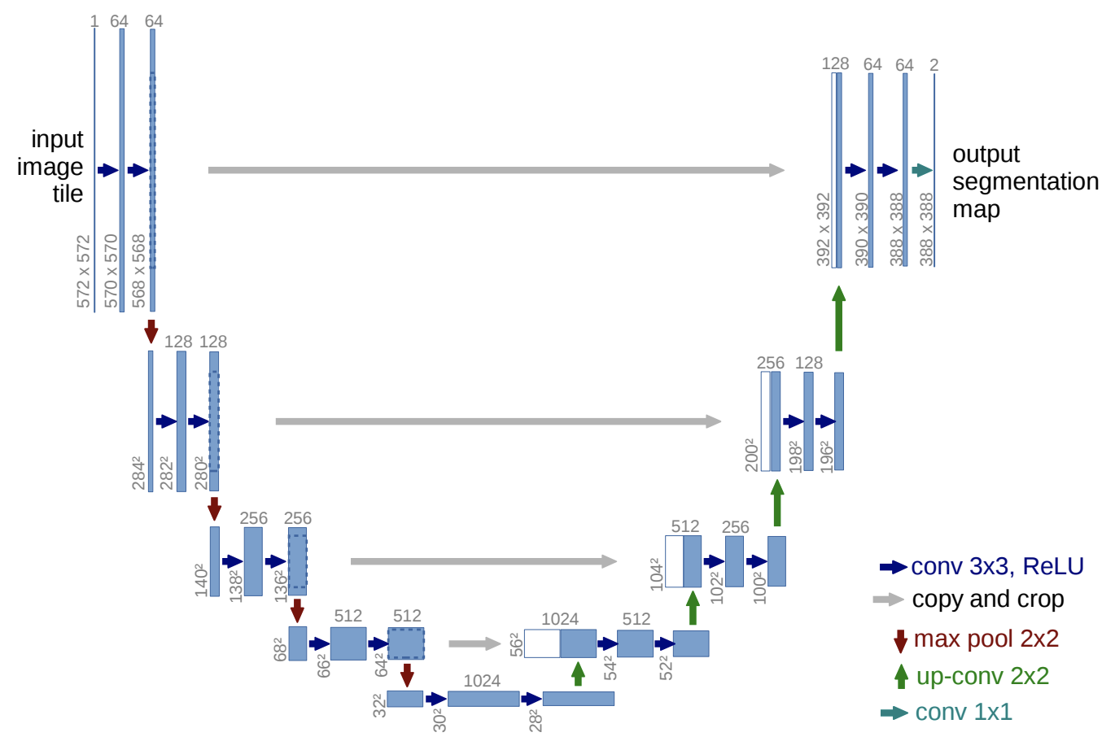
Literature Overview
Notes:
Describe the general structure of a U-Net and its «sub-structures»: contracting and expanding paths
So, let’s see how the SOTA architectures managed to succeed in this particular segmentation task,
What are the benefits involved with the self-attention and the Transformer architecture,
And how I combined these knowledge to get something new that could compete with those.

Slide 22
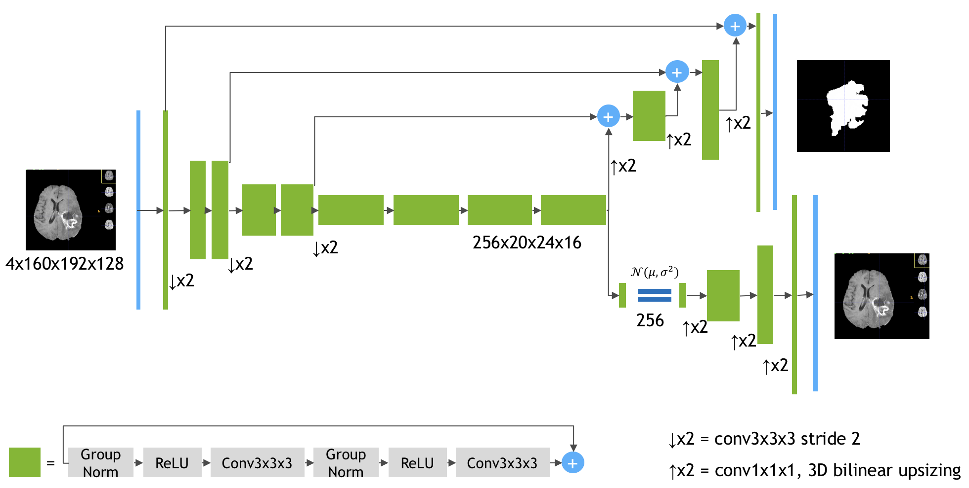
SegResNet
3x160x192x128
4x160x192x128
Myronenko A., 2018. 3D MRI brain tumor segmentation using autoencoder regularization, arXiv:1810.11654
Notes:
Describe the salient features of this network
The dataset used
The results obtained by researchers
This approach won the 1° place in 2018 BraTS challenge. Proposed by Andriy Myronenko, this model for semantic segmentation is based on encoder-decoder architecture with two heads:
The first is the segmentation head that produces final segmentation output of the 3D volume
The second head is used instead to reconstruct the original input: it is the final part of a variational auto-encoder branch that is added to regularize the shared decoder and impose additional constraints on its layers.
The contracting path level is composed by a sequence of residual blocks, each one composed by Conv3d, ReLU and a Pre-GN as first layer in the convolution «sub-block»: this reorganization of the layers supports better gradient flow and removes the necessity of a warm-up stage.
The expanding path is composed by the same residual blocks paired with 3D bilinear upsampling layers: no transpose convolution is used to expand the spatial dimension -> the model is less demanding with memory, but certainly has reduced capacity w.r.t. the other solutions.

Slide 23
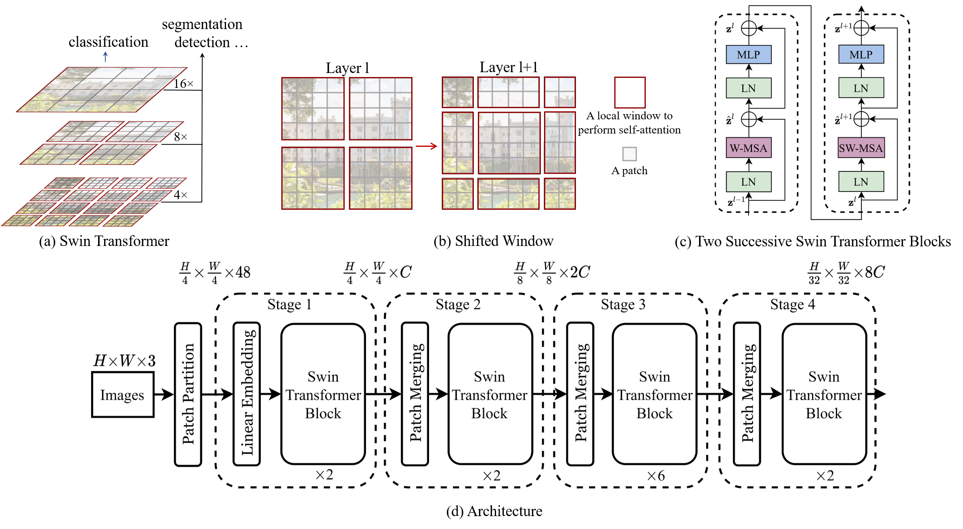
Shifted Windows Transformer
Liu, Z., Lin, Y., Cao, Y. et al., 2021. Swin Transformer: Hierarchical Vision Transformer using Shifted Windows, arXiv:2103.14030
Notes:
Reprise the concept of Attention and explain how the resaerchers address the problem of cross-correlation between patches
This paper present a new Vision Transformer and a new way to compute an image representation. The main challenges in adapting the Transformer architecture from NLP to Vision arise from the differences between the two domains such as:
Large variantions in scale of visual entities
High resolutions of pixels in images w.r.t. words in text.
And the lack of inductive biases (locality, translational invariance) from the attention mechanism.
In previous Transformer-based model the tokens were either all of a fixed scale or following a fixed partitioning scheme: properties unsuitable for many vision applications, but necessary for a task such as semantic segmentation that requires dense prediction at pixel level, the problem would have become intractable as the computational complexity is quadratic to image/patch size.

Slide 24
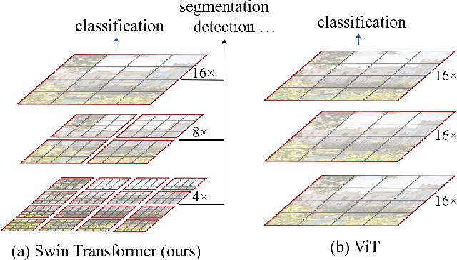
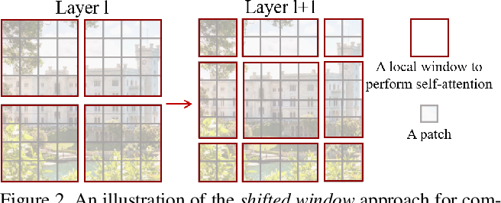
Shifted Window Mechanism
(a.1) Swin-Transformer
(a.2) ViT
(b) Shifted Window
Notes:
The shifted windowing scheme instead, brings great efficiency by:
limiting self-attention computation to non-everlapping local windows
allowing for cross-window connection
constructing a hierarchical feature maps with only linear computational complexity to image size, bounded by a fixed number of patches per window in each layer.
The key design element of Swin Transformer is indeed the shift of the partition scheme between consecutive SA layers: the shifted windows bridge the windows of the preceding layer, providing connections among them significantly enhance modeling power.

Slide 25
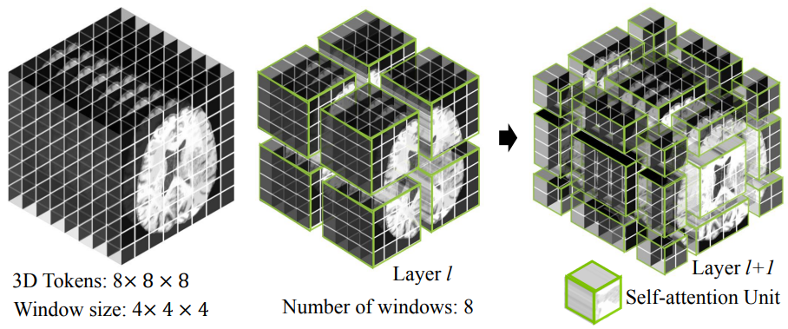
3D Volume shifted segmentation
Notes:
The same partitioning scheme can be adapted on 3D volumes as well, as so did Hatamizadeh and his research grup when developping the Swin UNet Transformer (Swin UNETR)

Slide 26
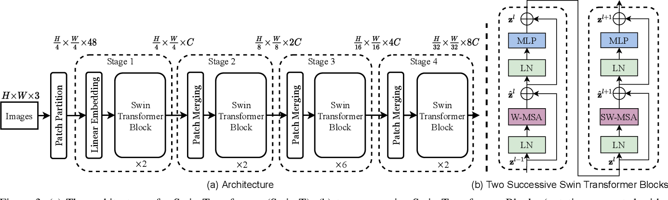
Literature Review

Slide 27
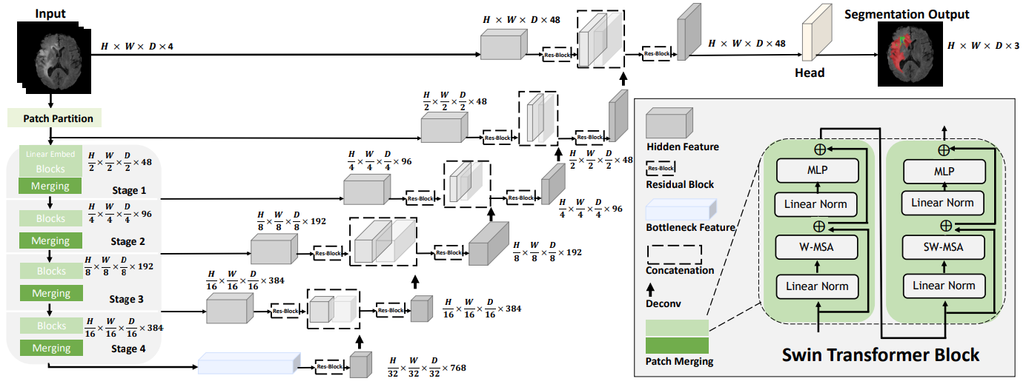
Swin UNetTRansformer (Swin UNETR)
Hatamizadeh, A., Nath, V., Tang, Y. et al., 2022. Swin UNETR: Swin Transformers for Semantic Segmentation of Brain Tumors in MRI Images, arXiv:2201.01266
Notes:
Describe the salient features of this network
Note the difference with the previous Transformer block: W-MSA -> SW-MSA
The dataset used
The results obtained by researchers
The «U-shaped» network architecture has achieved SOTA performance benchmark on different 2D and 3D semantic segmentation tasks,
But it is also constrained by a limited kernel size while modeling long-range information in a particularly long sequence and this can lead to deficiensies in the segmentation of tumors with variable sizes.
On the other hand, transformer models have demonstrated excellent capabilities in capturing such long-range information in multiple domain, CV included.
The task of 3D brain tumor semantic segmention is reformulated as a sequence to sequence prediction problem wherein multi-modal input data is projected into a 1D sequence of embedding and fed to a hierarchical Swin Transformer as the encoder.
The encoder extracts features at five different resolutions and it is connected to a FCNN-based decoder at each resolution via skip connection.
This approach was proposed in 2021 BraTS segmentation challenge, ranking among top-performing approaches in the validation phase.

Slide 28
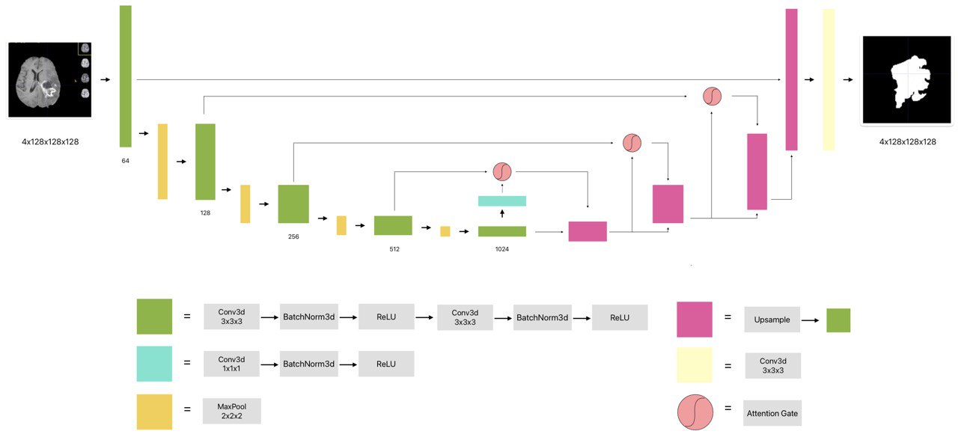
Attention U-Net
Notes:
Describe the salient features of this network
The results obtained by researchers
The dataset used (not for Brain Tumour Segmentation)
Why did I choose this model as the base for my work
How did I improve it
Now let’s see the model that I renew for the task of Brain Tumor Segmentation: in 2018 the Attention U-Net was proposed as a model for semantic segmentation for medical imaging equipped with a special layer that automatically learns to focus on target structures of varying shapes and sizes. Tested on CT abdominal datasets for multiclass image segmentation, the model showed consistently to improve the prediction performance accross different datasets while preserving computational efficiency.
The special layer, namely attention gate (AG), was a simple yet effective solution that allowed CNN models to be trained from scratch in a standard way, but with the advantage that AG automatically learn to focus on target structures without additional supervision. At test time, AG generate soft region proposals implicitly on-the-fly and highlights salient features for a specific task.

Slide 29
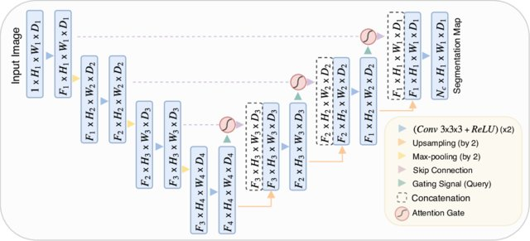

Slide 30
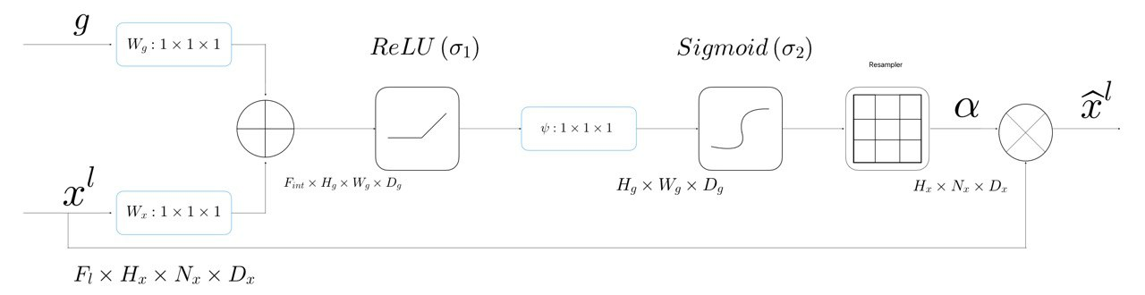
Attention Gate
Notes:
Briefly describe what this Gate does and how
(?) Explain the differences between dot product attention and additive attention
Comment on the versatility of this kind of solution (easily integrable in any kind of CNN)
Input features (x^{l}) coming form a residual connection are scaled with attention coefficients (a) computed in the AG.
These are computed from the combination of both the input features and the contextual information provided by the gating signal (g) collected from coarser scale.
Before the scaling is applied, a trilinear interpolation is applied to align the attention coefficients to the input features.
In standard CNN architectures the feature-map grid is gradually downsampled to capture sufficiently large semantic contextual information (namely, location and relationship between tissues), modeled by features on the coarse spatial grid level. Despite the difficulty of reducing false-positive predictions for small objects that show large shape variability, AGs achived good results without relying on additional preciding object localisation models to simplify the task into separate localisation and subsequent segmentation.
Once activated by the sigmoid, the attention coeffcients a \in [0, 1] progressively suppress feature responses in irrelevant background regions, preserving only the activations relevant to the specific task.

Slide 31
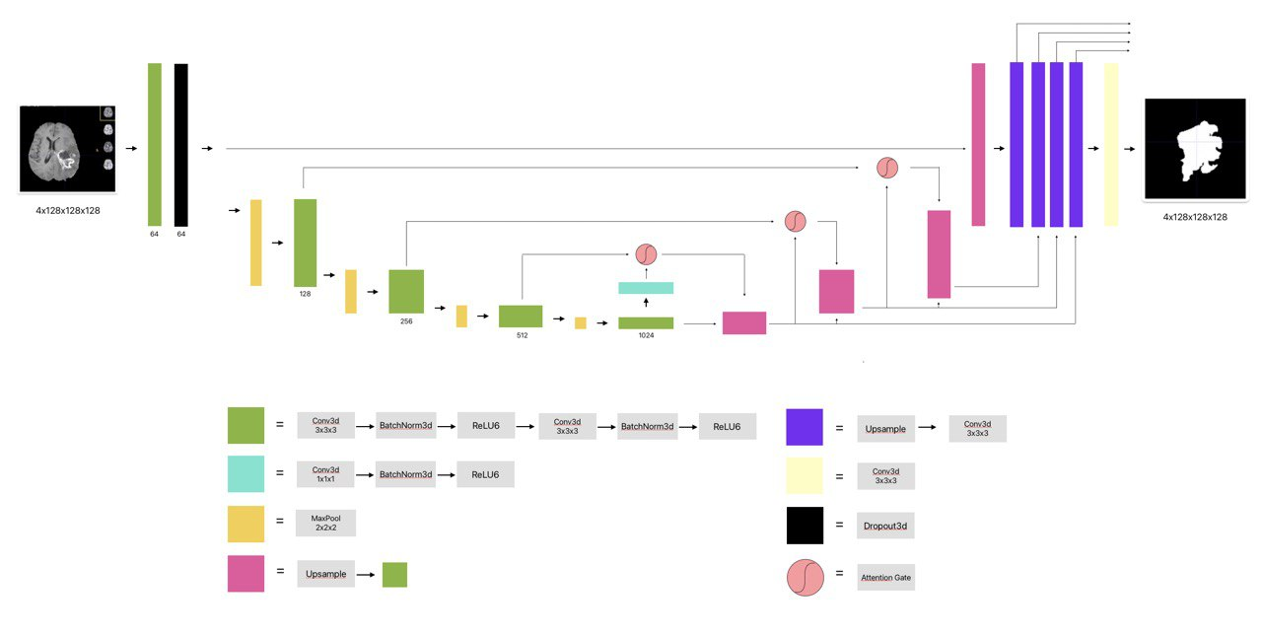
nnAttention U-Net
Notes:
Despite being prov, en to be a powerful model on multi-organ segmentation, the same architecture performed poorly once tested «as it is» , no matter if I trained the original implementation (found on the GitHub page of the authors) or the one provided in the Medical Framework I used for my experiments.
After a careful examination of the implementations I found that both the versions diverted from the original paper in some aspects:
The framework version had removed the deep-supervision mechanism
The original implementation made a variation on the deep-supervision heads: instead of computing directly the companion losses for the hiddden layers, it simply stacked and then convolved them to be the final prediction feature-maps, computing the total loss of the network only on the final output.
Both the networks managed the dropout mechanism badly:
The original version completly ignored it
The other implements 1D Dropout layer in between every Convolution layer, not only leading to poor peformance, but also to bad overfitting. The network is fully convolutional and natural images exhibit strong spatial correlation, the feature map activations are also strongly correlated, and in this setting standard dropout fails.
It is for this reason that starting from the original implementation I adjusted all these parts with a long series of ablation studies: by integrating, tweaking and removing the best methodologies and components to adapt this network to my problem. I eventually come up with this configuration:
A symmetric Unet
A Spatialdropout layer is placed only after the initial Residual Block: applying more dropout in between the block, or after each block has never shown any improvement
The hidden layers in the decoder are first upsampled, then propagated to the final output layer, convoluted all together to produce the final segmentation map and returned singularly to compute companion losses
The upsampling mechanism involves learnable kernels instead of a simple upscaling algorithm

Slide 32
Methodology

Slide 33


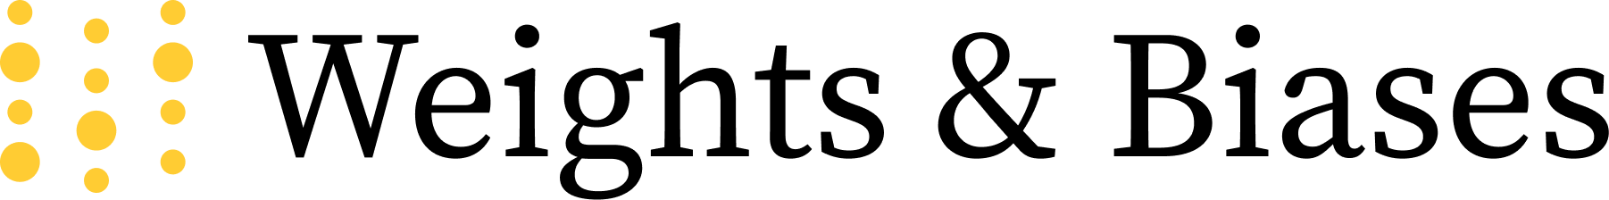


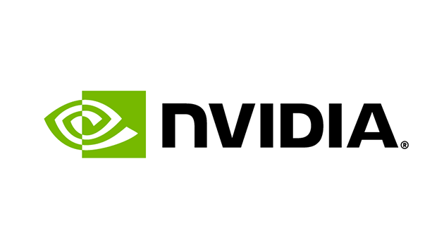
Methodology
Notes:
Describe briefly the usage of each framework (in particular MONAI)
Describe the HW used for the experiment
Before getting to the ablation studies and the results obtained, let me introduce the frameworks I used for conducting all the experiments:
With the intention of producing a reproducible, flexible and research oriented piece of work, and not being backed by powerful hardware support, I levereged the open frameworks that most suited my needs and offered powerful tools for free.
All the code written for my work, from data visualization and analysis to network modeling was written in Python.
The networks, loss and score functions created with components already implemented in a framework of the PyTorch ecosystem
The code organized following the logic of Lightning Modules to easily decouple the data processing from train&val logic while maintaing a high level of flexibility for testing out new ideas, integrate effective training techiniques, enable half precision and manage the experiments in conjunction with Weights&Biases
A framework for visualization of live metrics, storage of checkpoints, data and metadata produced while training and tracking the models evolution.
MONAI is an open source framework built for accelerating research in Medical Imaging. It provides reproducibility of research experiments for comparison against the SOTA implementation thanks to an incredible number of tutorials, guides and documentation; but according to my experience, the integration of some best practice of AI development for healthcare and the high level of user friendliness impose a stiff overstructure that poorly lends itself to new experimentation and only facilitate hyper and finetuning experiments of existing solutions.
Finally, kaggle: it is a data science and artificial intelligence platform providing for free many fundamental resources: storage for the dataset, usage of an Nvidia Tesla P100 GPU with 16GB memory (minimum requirement for training most of the medical models I tested), background code execution (on cloud servers) long training sessions (up to 12 consecutive hours) and a precise system of accountability that allowed me to plan carefully all the training sessions. Of course all these benefits come with some limitations, the greatest being the cap for dataset size both in terms of examples and memory (1000 files and 20 GB after file decompression). Luckily enough, this limitation did not impact the dataset used for my experiments, since my dataset was just under 500 examples.

Slide 34
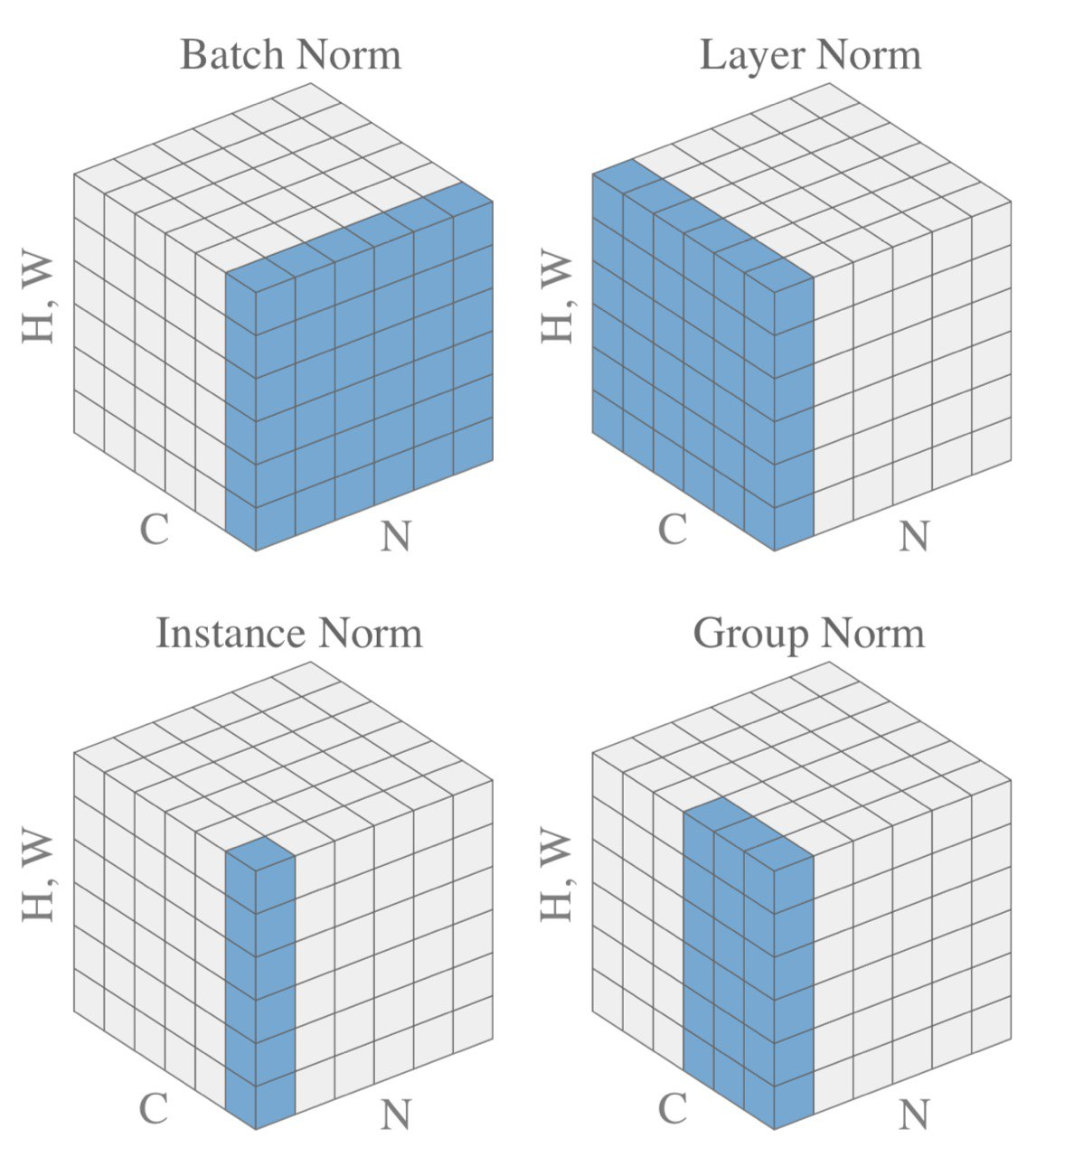
Ablation Studies
16
32
64
128
256
48
96
192
384
768
32
64
128
256
512
Batch/Channel Normalization
Feature Dimensionality

Slide 35
Hypertuning and Ablation Studies
16
32
64
128
256
32
64
128
256
512
48
96
192
384
768
32
64
128
256
1024
Feature Dimensionality
Notes:
Let’s now overview some of the key hypertuning and ablations studies conducted in my experimentations:
One of the first test was to stress out the GPU memory capacities: instead of finding the «perfect number of batch size» (that I took instead as a fixed parameter from the original papers) for a fixed sequence of kernels, I tested out several variants by either doubling the stacked kernels per level in the contracting path, by trying unusual sequence of filters inspired by other popular papers or doubling the number of filters for a single level.

Slide 36
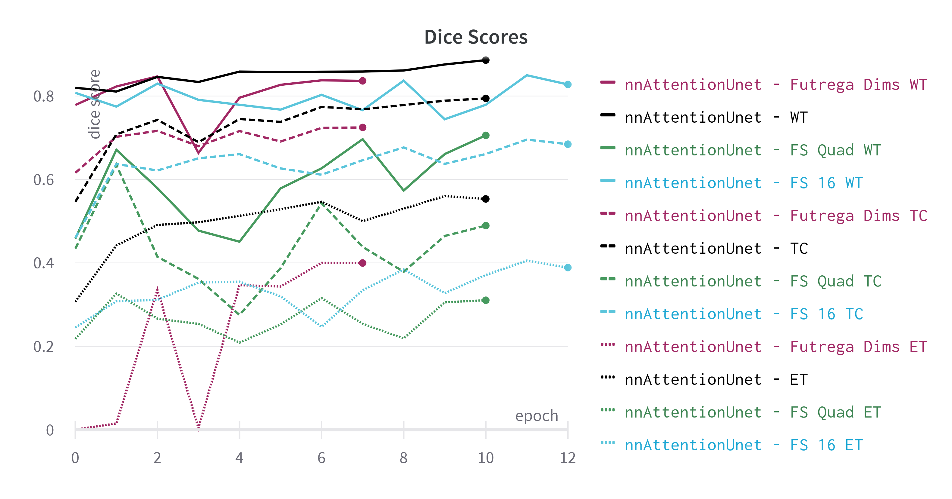
Hypertuning and Ablation Studies

Slide 37
Hypertuning and Ablation Studies
Batch/Channel Normalization
Notes:
Again, working with limited hardware resources and following the training setups of the previous papers, I faced the problem of data normalization for the optimization of gradients flow during the backpropagation phase, and while most of the papers use either Instance or Group Norm because of the reduced batch size at training time, I found to be more effective the combination of Batch Norm with gradient clipping. The latter is for avoiding gradient explosion, while the former does a better job than the other normalization layers possibly because:
The learnable parameters (\gamma and \beta) for the affine transformation and tracking the running statistics over the whole dataset should suffice to «fill the gap of a large batch»

Slide 38
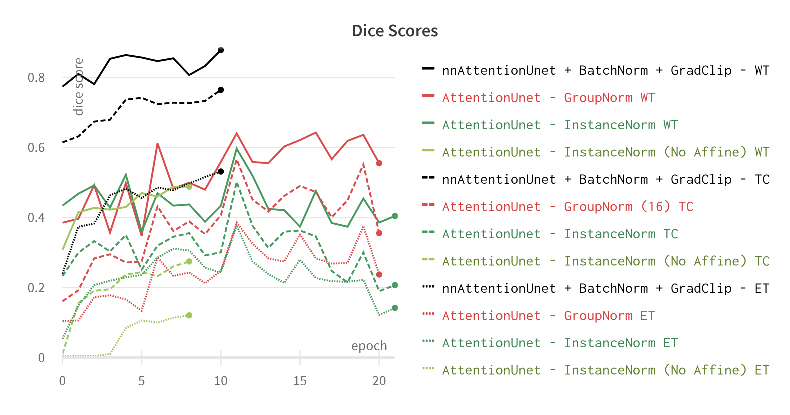
Hypertuning and Ablation Studies

Slide 39
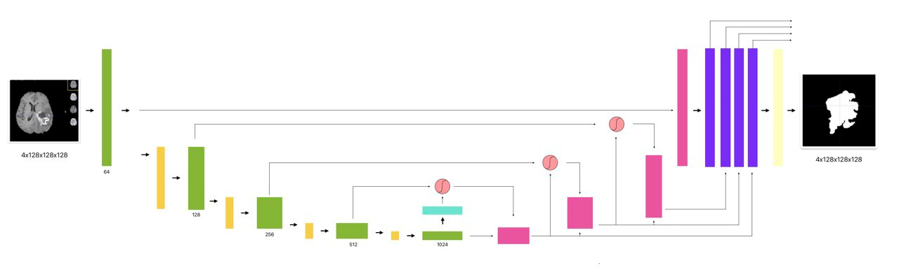

Hypertuning and Ablation Studies
Spatial 3D Dropout
Notes:
As mentioned earlier, the implementations of the Attention Unet either left out any kind of dropout layer, or used a «non-fitting type» for the segmentation task.
So, I first introduced the spatial 3d dropout layer to promote independence between feature maps (instead of just dropout adjacent pixels within feature maps that are with all probability strongly correlated) and test different setups within the Residual Blocks in the contracting path:
At first after each convolution
then right after each single Block (with and without the dropout in the block)
And finally only after the first Residual Block, this configuration resulting the best alternative as it led to both good performance and better generalization

Slide 40
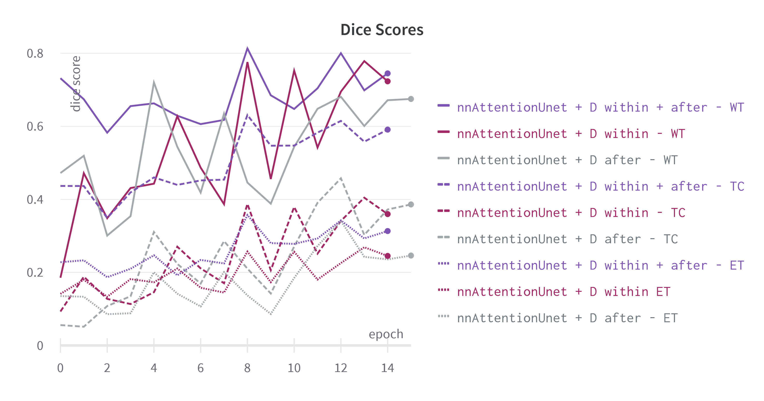
Hypertuning and Ablation Studies
Notes:
Here some results: despite obtaining decent results for the WT segmentation score, except for the combination «within + after» the others perform badly on the other labels, however…

Slide 41
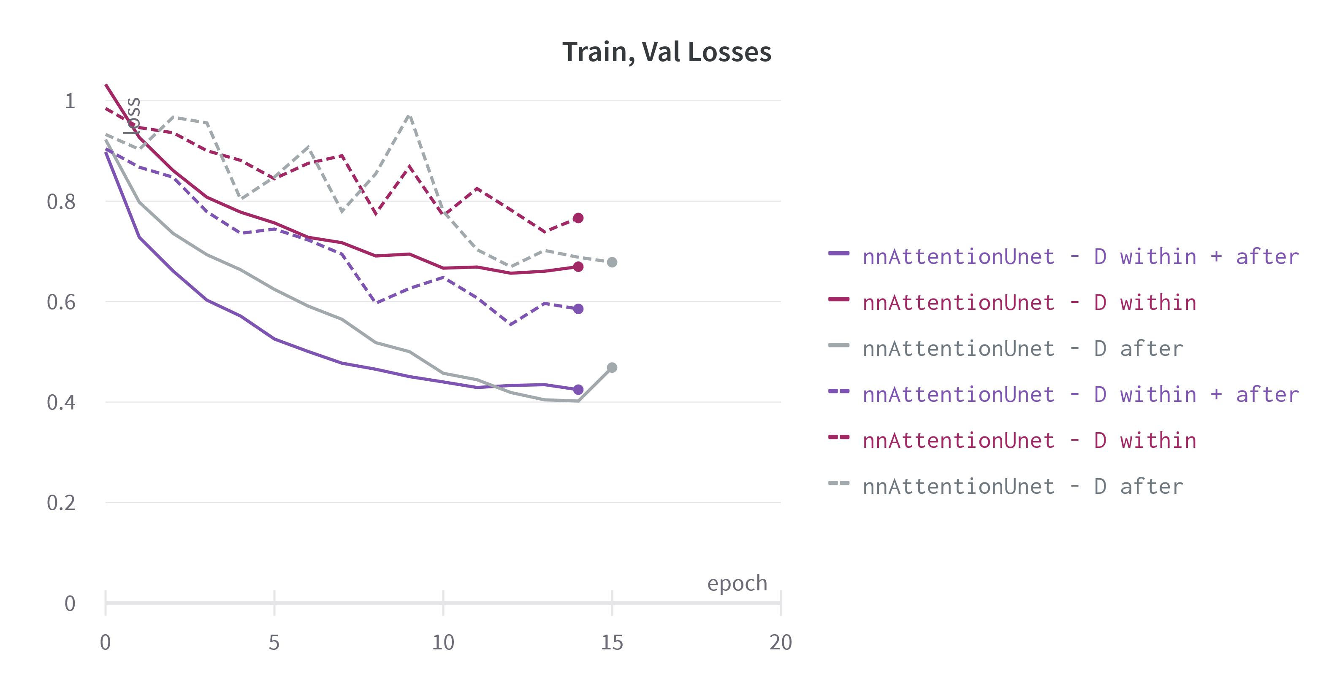
Hypertuning and Ablation Studies
Notes:
All 3 are not enough to achieve a good generalization level

Slide 42
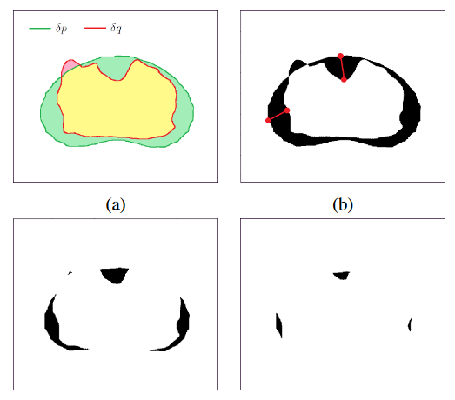
Hypertuning and Ablation Studies
Hausdorff Distance Reduction
Notes:
The final major improvement was to introduce the Hausdorff Distance as a loss to be minimized at training time, instead of just using it as a companion metric for model evaluation.
This method estiamtes the HD from the segmentation probability map produced by the network applying morphological erosion on the difference between the predicted and the real mask.
First introduced to train CNNs for segmenting human organs in ultrasound, MRI and CT scans, it proved to be a valid tool to reduce large segmentation error.
My biggest concern in using the HD for all the 3 tumor subregions arised from the highly irregular, non-convex and possibly discontinuos shape of the EN: reducing its component for in the overall loss could have been particularly challenging so I reformulated the final loss taking in consideration only the HD computed for the WT and TC predictions.

Slide 43
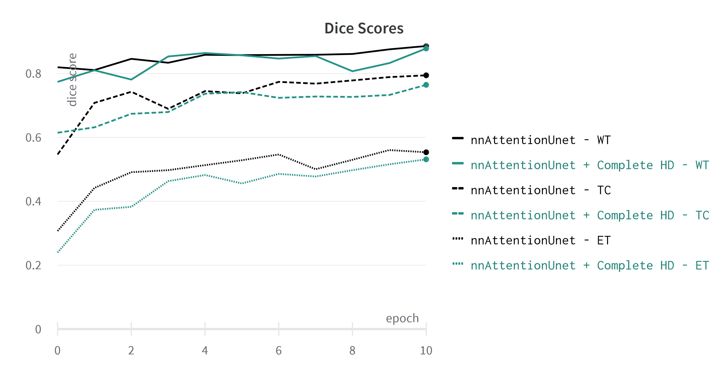
Hypertuning and Ablation Studies

Slide 44
Results

Slide 45
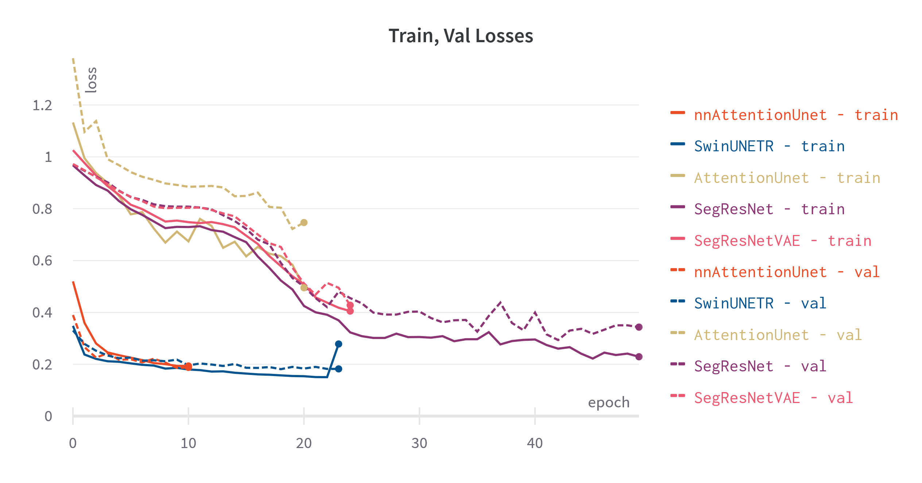
Quantitative Results

Slide 46
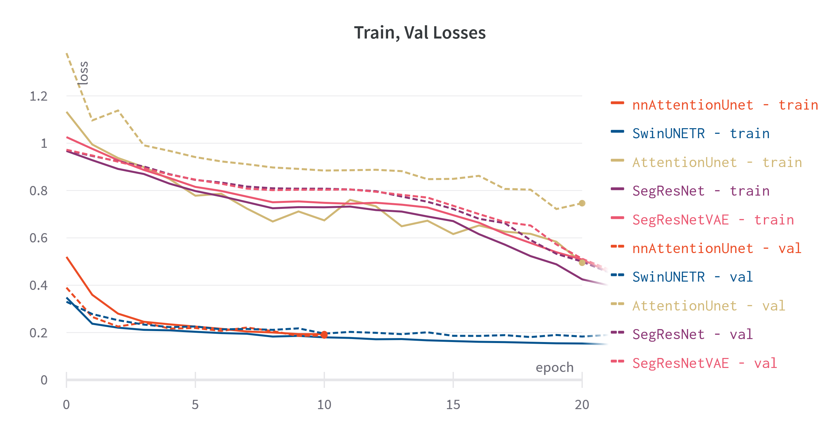
Notes:
Focus on the previous graph

Slide 47
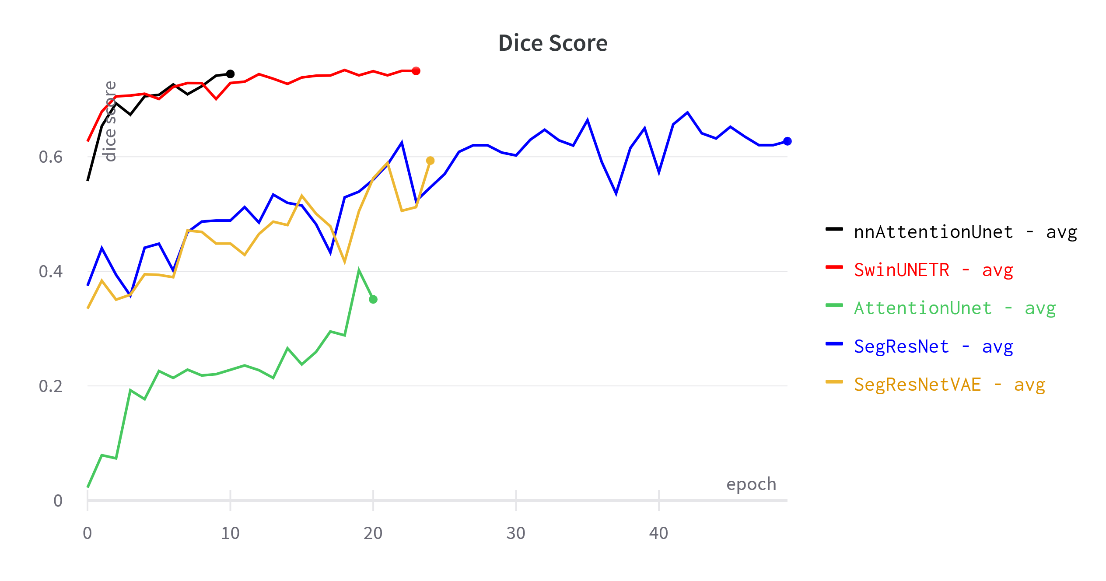
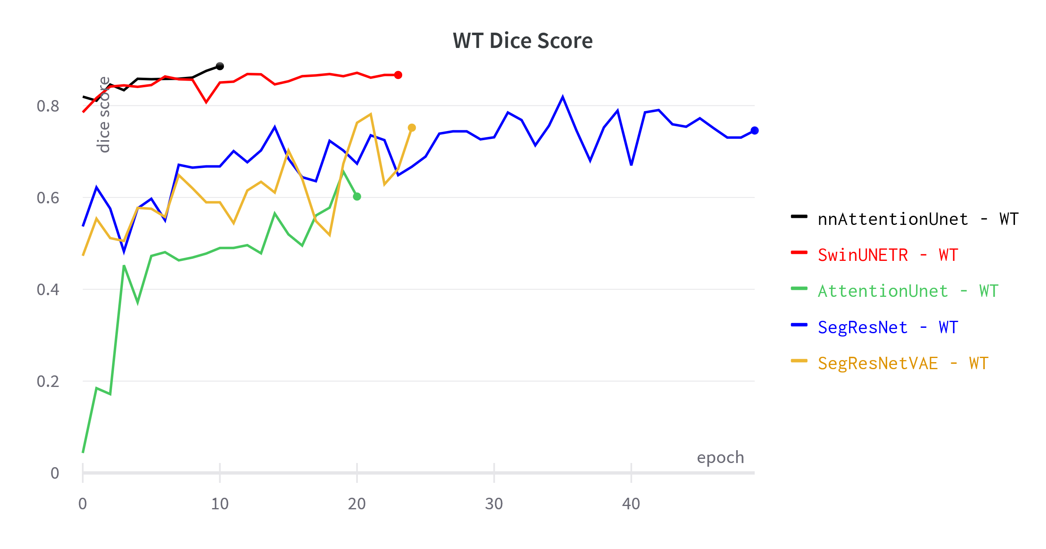
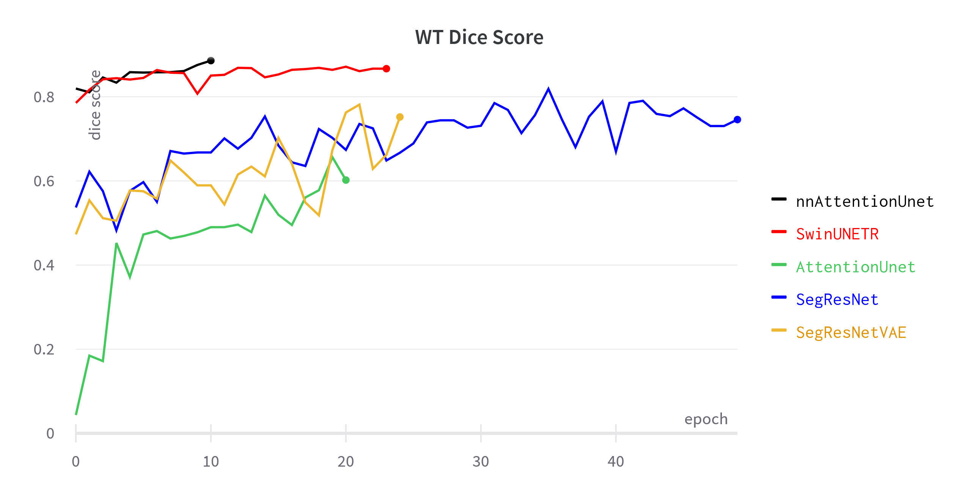



Slide 48







Qualitative Results
Ground truth
SegResNet
SegResNet-VAE
SwinUNETR
Attention UNet
nnAttention UNet

Slide 49






Ground truth
SegResNet
SegResNet-VAE
SwinUNETR
Attention UNet
nnAttention UNet

Slide 50




Future Work
use more data
scale up

Slide 51

Future Work
Kirillov, A., Mintun, E., Ravi, N. et al., 2023. Segment Anything, arXiv:2304.02643

Slide 52
Thanks for the Attention

